Slide 1
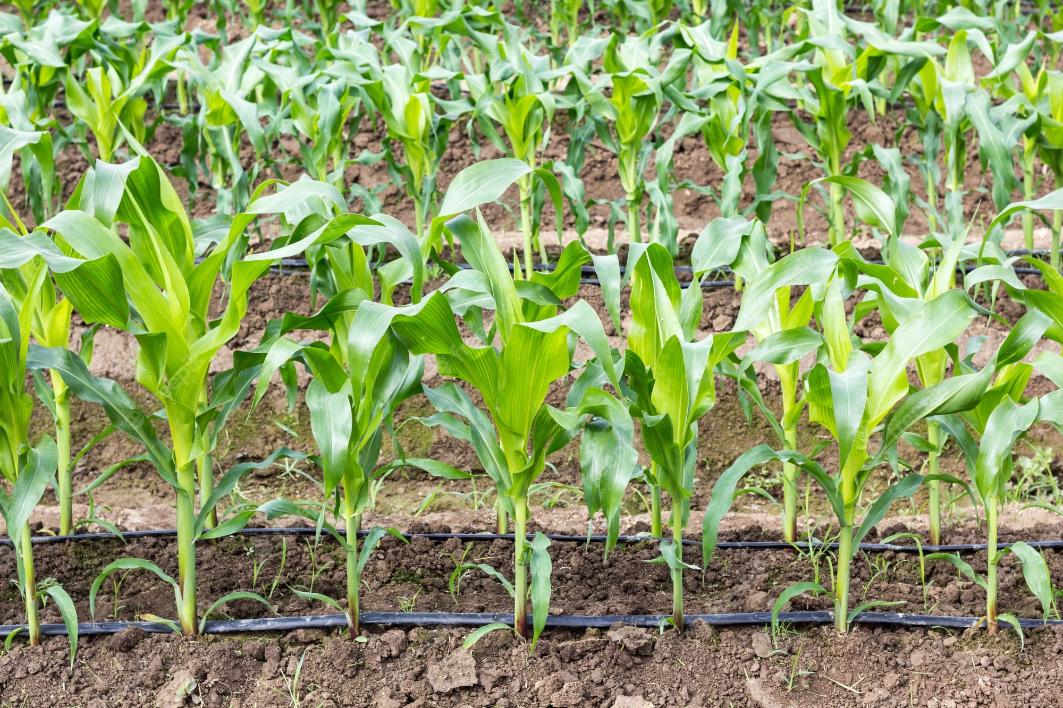
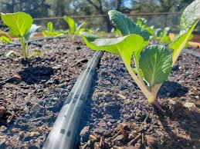
WATER MANAGEMENT
Decision Analysis and Forecasting in Agriculture
Adrien Knobloch, Aparna Sri, Silas Oyieyo, Steven Kiwewesi

Slide 2
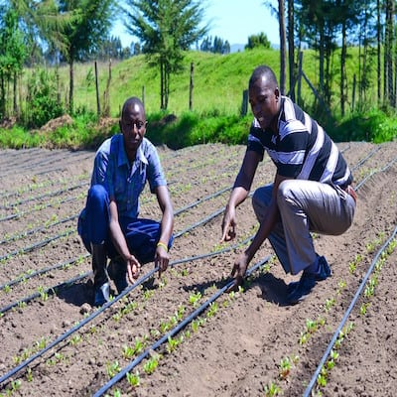
INTRODUCTION
Kenya has great potential for underground water exploration for irrigation to increase food production and liberate from seasonal agriculture dependency.
Around 80% of Irrigation scheme are still under Farrow Irrigation.
Adoption of Drip Irrigation as a way to reduce the amount of water use and ensure ample agricultural production.
Government of Kenya is the targeted implementer of the project.
https://www.engineeringforchange.org/wp-content/uploads/2018/04/SunCulture-Drip-Irrigation-Kit-1
2

Slide 3
Objective of the Project-
1.To maximize Water use Efficiency and management in Mwea Irrigation scheme to enhance the crop productivity and environmental related benefits.
2.To check the adoption capacity of the project by the government using the known public investment standards (cost-Benefit Analysis, Net Present Value).
Methodology for the Analysis-
Stakeholder Analysis> Conceptual Model>Impact Pathways
Expert Calibration>Simple & Complex Model
R packages
Decision Makers-
The Government of Kenya.

Slide 4
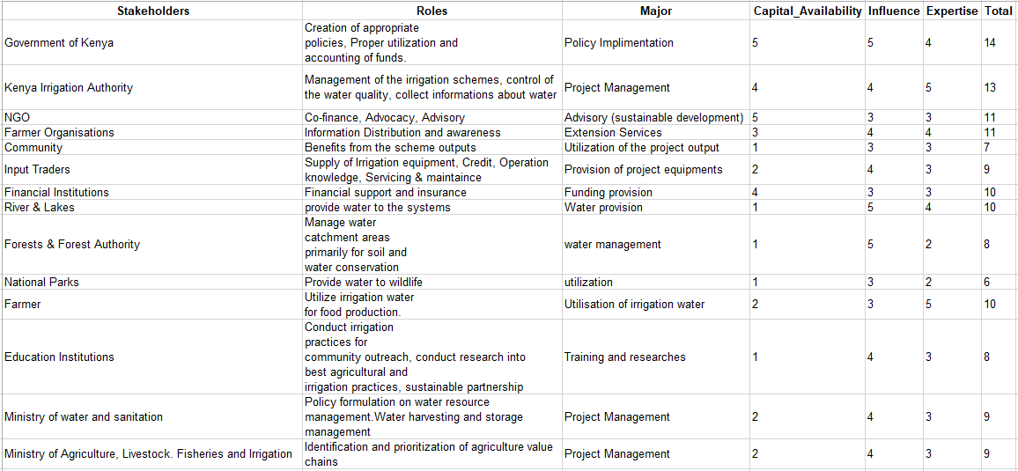
STAKEHOLDER ANALYSIS
List of 14 stakeholders
Defined their roles and the major one
Ranked their :
Capital availability
Influence
Expertise
3

Slide 5
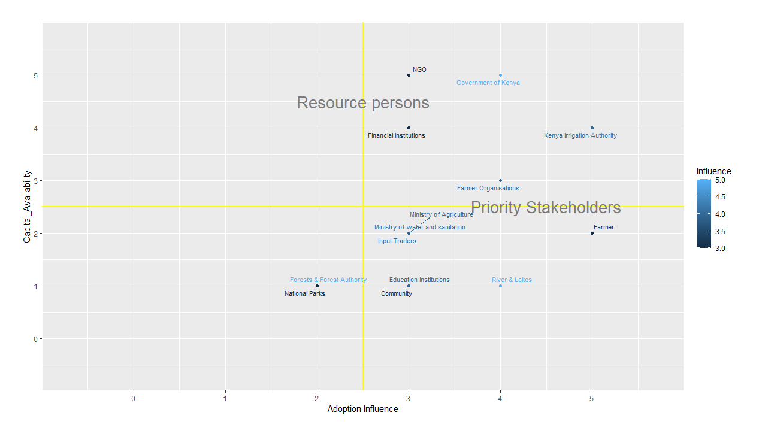
STAKEHOLDER ANALYSIS
Confirm our choice of the Government as the decision maker
Expertise
4

Slide 6
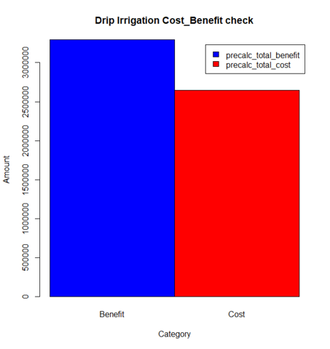
PROJECT EVALUATION
The viability of the project is based on analysing the scope and the intermediaries.
Evaluation of the cost and benefit is analysed.
Includes, Budgetary Return analysis
silas
5

Slide 7
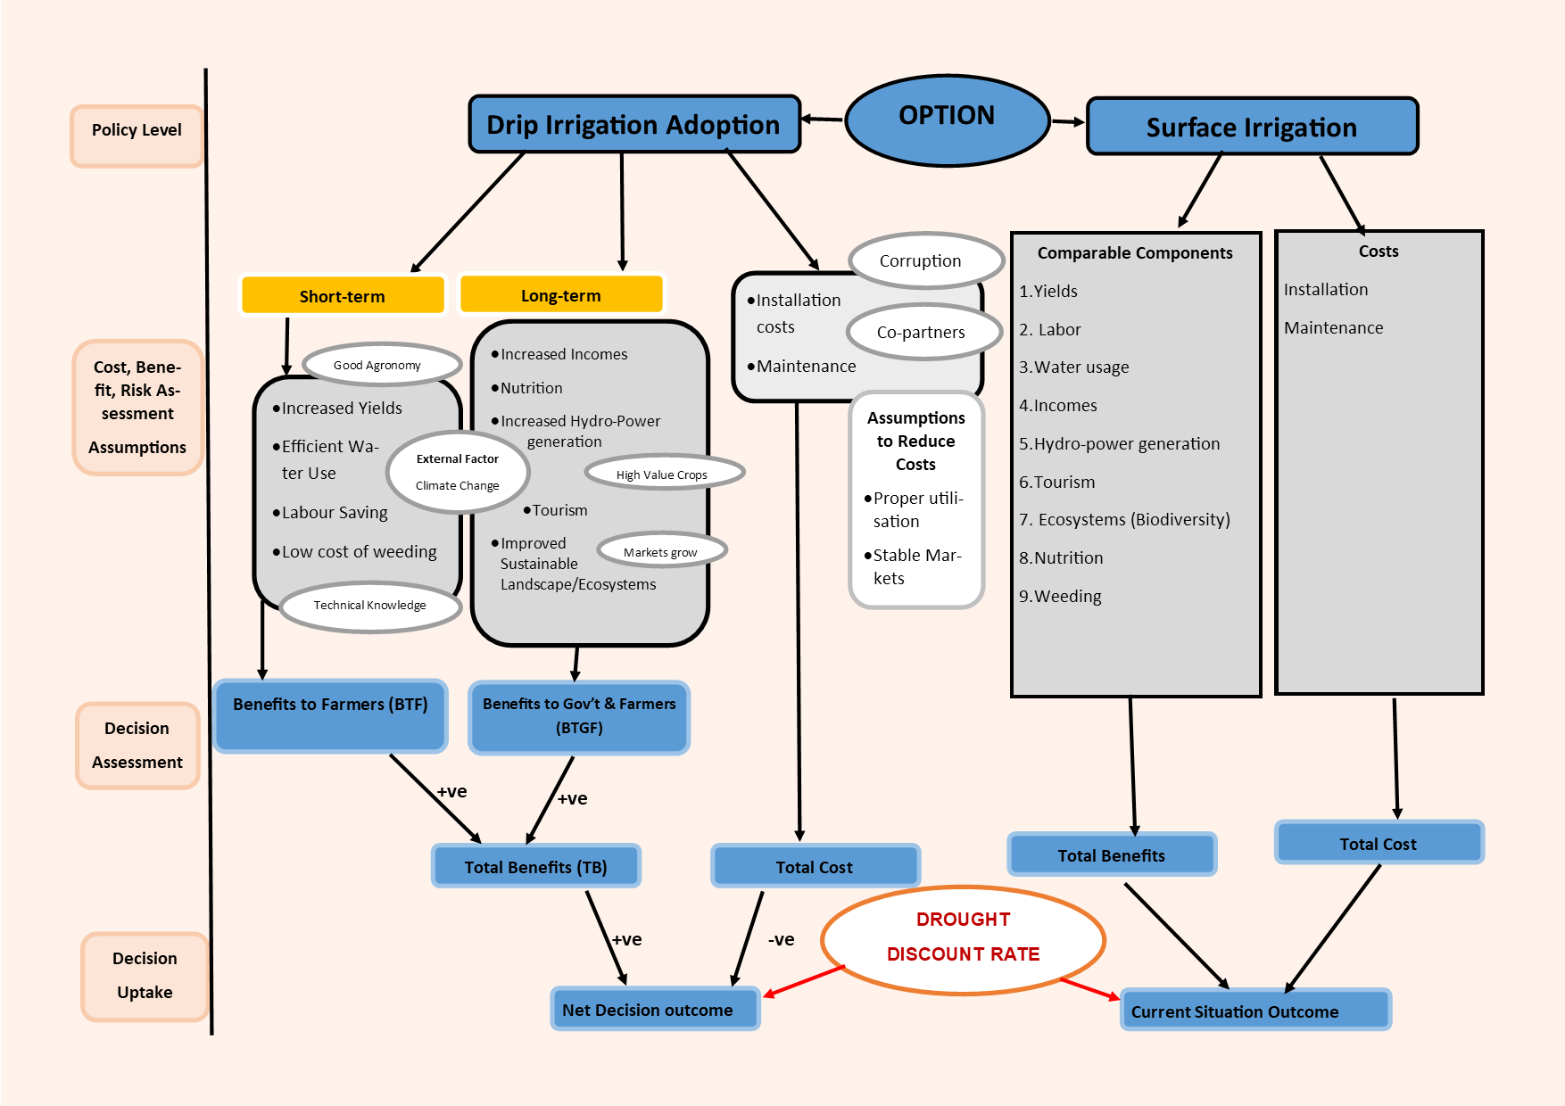
CONCEPTUAL MODEL
6

Slide 8
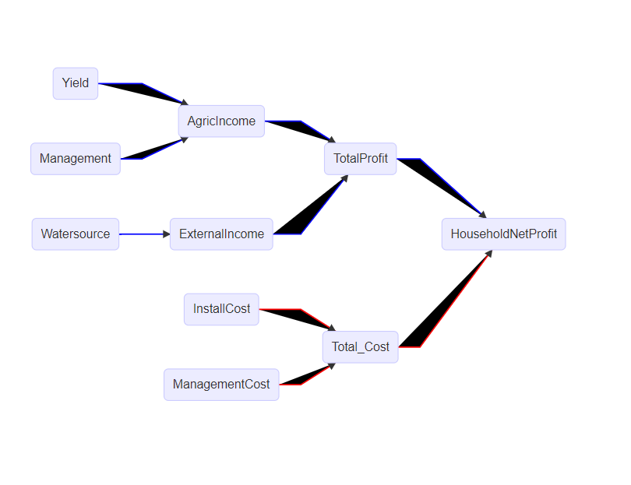
IMPACT PATHWAY
Sri
Water Management
7

Slide 9
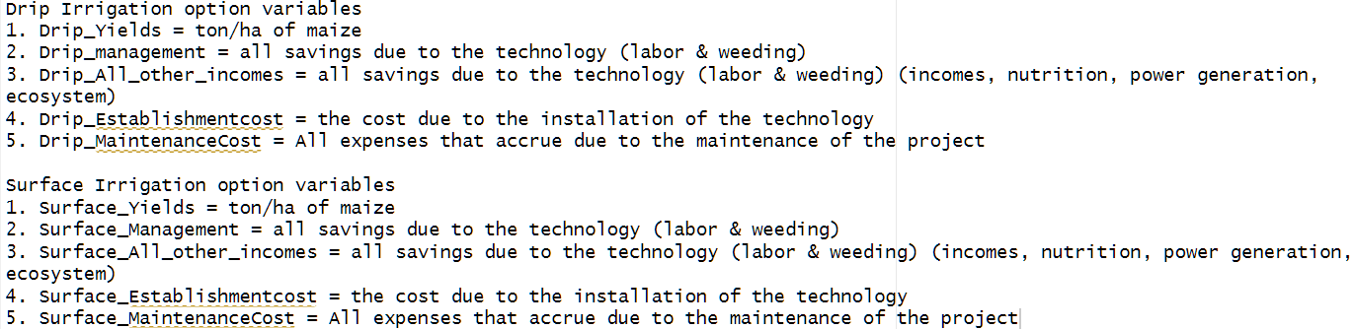
ESTIMATES
Water Management
8

Slide 10
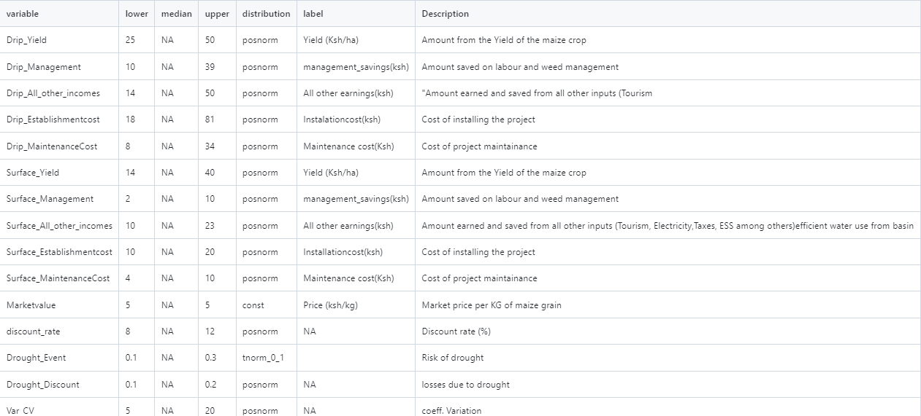
ESTIMATES

Slide 11
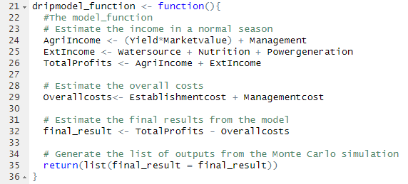
SIMPLE MODEL
What to improve ?
Add drought event
Add vv/NPV function
Merge surface/drip irrigation models
Water Management
9

Slide 12
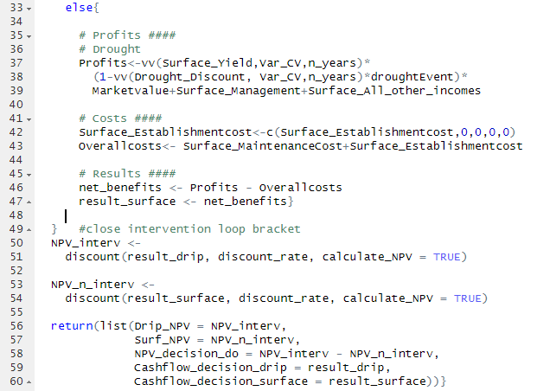
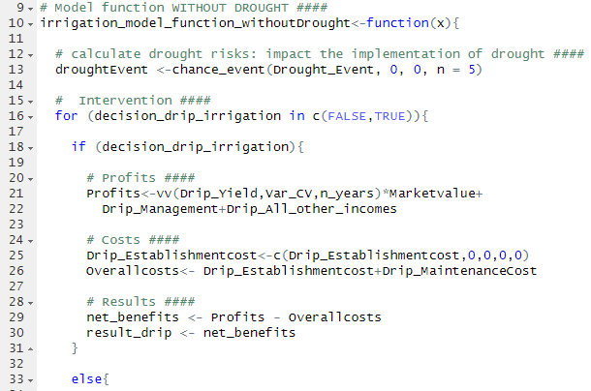
MODEL UPGRADE
WITHOUT DROUGHT
Water Management
10

Slide 13
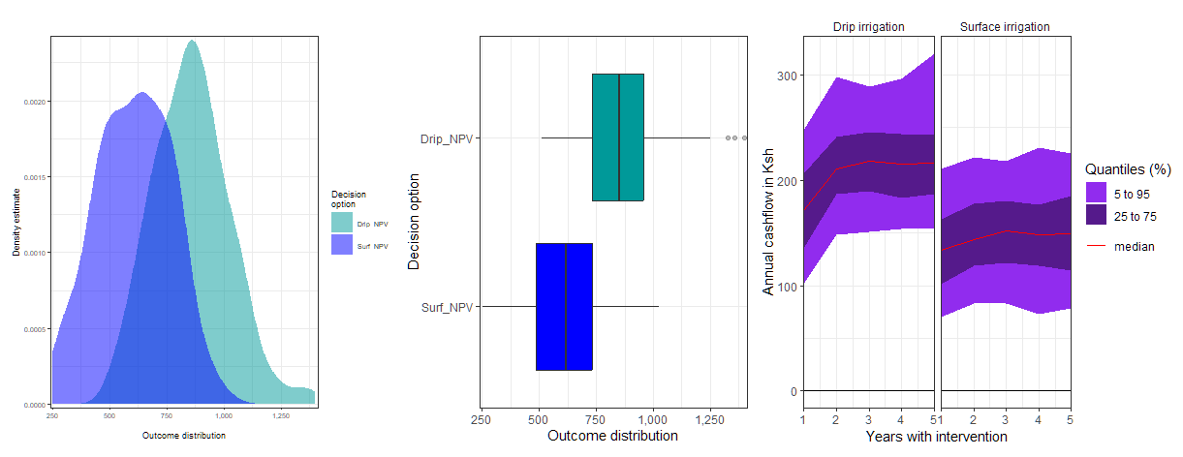
Result without Drought

Slide 14
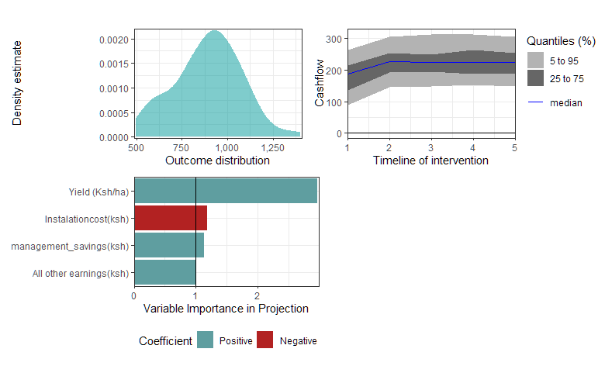
Compounding Result , Drip without drought
Distribution
Sensitivity analysis
Information importance

Slide 15
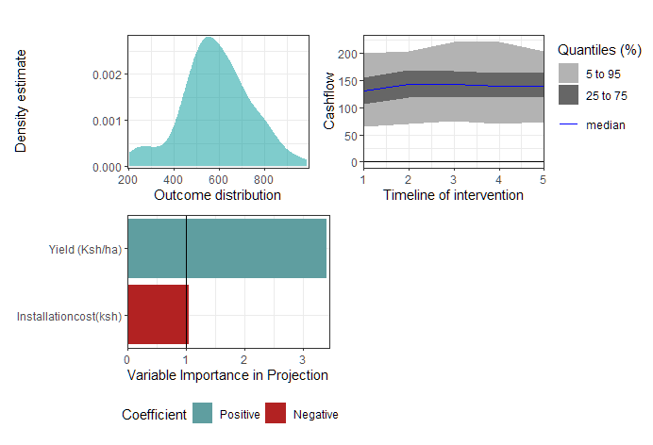
Compounding Result, surface without drought
Distribution
Variable importance
Cash flow over n, period

Slide 16
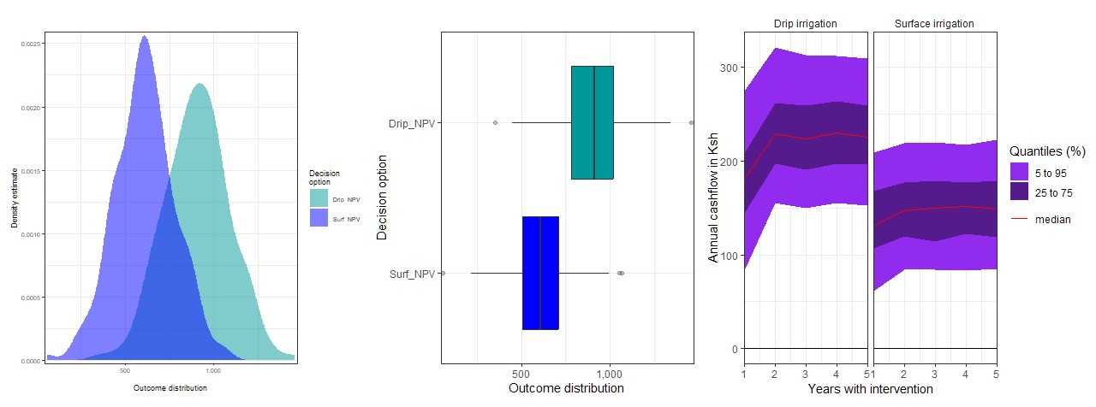
WITH DROUGHT
Achieved through the Altering of the chance_event () function to include value_if to be 1, value_if_not to be 0 for the 5 years
Plot_distribution; Outcome with the expected NPV and the boxplots with the median outcomes with outliers
Cashflow: Distribution of the cashflow for the period of 5 years of assessment
12

Slide 17
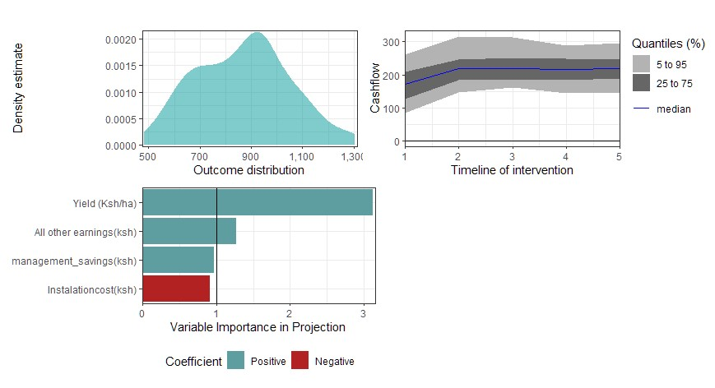
Drip Irrigation Compound Figure With drought
Single figure assessment to analyse the decision to take up the intervention or not
Value of Information and Variable inputs
13

Slide 18
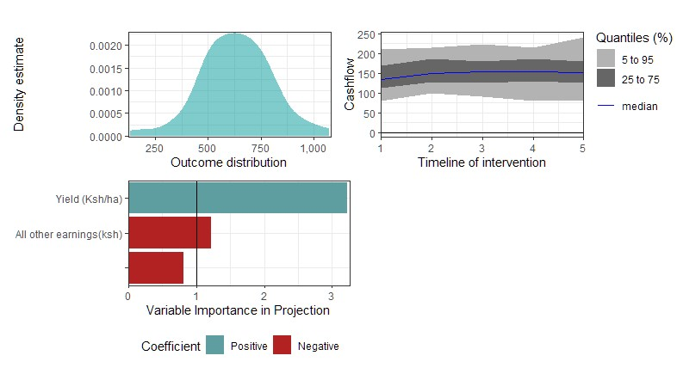
Surface Irrigation Compound Figure With drought
Single figure assessment to analyse the decision to take up the intervention or not
Value of Information and Variable inputs
14

Slide 19
Recommendation
Government of Kenya should consider drip irrigation over the conventional surface irrigation on vegetable and cereal plot areas.
Without Drought the the Installation cost variable is positively significant as it greatly impacts the outcomes. This should be limited.
The benefits are verse more and able to improve productivity, water use efficiency and promote eco_balance.
16

Slide 20
Insights
Consideration of all the stakeholders in the study area is important as their ideas and presentation of the interlocked, complex uncertainty relationships, best define the niches and the appropriate solution.
Integrating the different conventional methodologies and computer based models limites the bias. This offers clear insights into forecasting for better decision making processes (from Optimistic Skeptic)
With the R Programming language, more insight on the language and its packages have availed its importance in research.
Especially under uncertainty when appropriate decisions are required.
Water Management
15

Slide 21
REFERENCES
The status and challenges of a modern irrigation system in Kenya: A systematic review
The social discount rate in the evaluation of investment projects: an application for Ecuador:
Farmer-led irrigation development in Kenya: Characteristics and opportunities:
Strengthening agricultural water efficiency and productivity on the African and global level
Water Management
17

